Slide 1

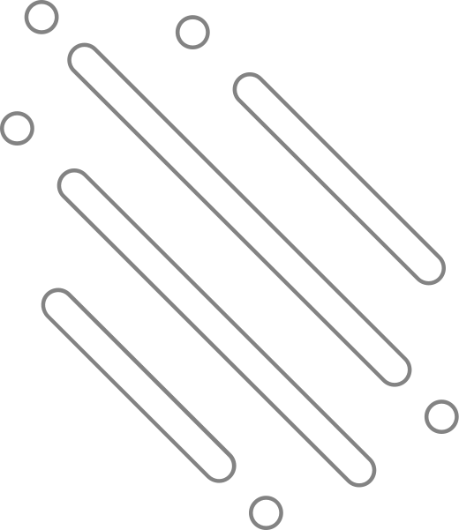

LIFT
CONTROL SYSTEM
SECR1013-03 DIGITAL LOGIC
GROUP 4

Slide 2






PREPARED BY
Ng Yaw Kuan
Terence Lim Jian Yuan
Wong Jing Jie
James Sim Chia Tai

Slide 3
OBJECTIVE
  Design a 3-bit synchronous counter for the lift system controller
  Implement basic principles of combinational and sequential logic
  Test and check the functionality of designed circuit using Deeds
  Utilise the components of combinational and sequential circuits
  Develop problem-solving, logical thinking and teamworking skills
  Demonstrate and explain the operation of the lift system

Slide 4
BACKGROUND
  To implement a 8-level lift system
  Utilise 3-bit synchronous counter
  Added extra authentication features
  Circuits:
- Combinational circuit
- Sequential circuit
- Additional features

Slide 5
PROBLEM STATEMENT
  Lack strong security systems
  Unauthorised lift access
  Need for authentication from authorised personnel

Slide 6


SUGGESTED SOLUTION
  Card + 4-bit Password Protection
  Integrates advanced electronic components:
- 3-bit floor comparator
- 4-bit password comparator
- JK flip-flops as counters
- Basic gates to route signals

Slide 7
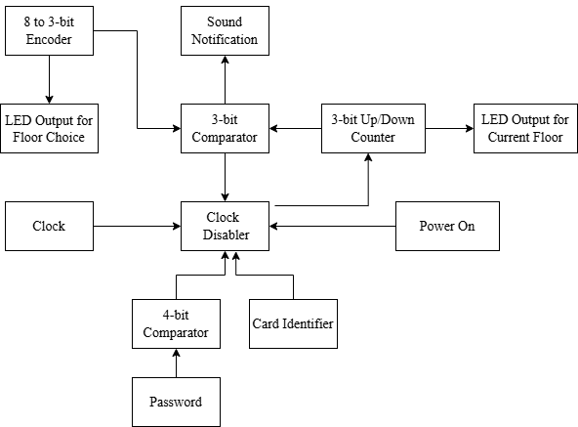
BLOCK DIAGRAM

Slide 8
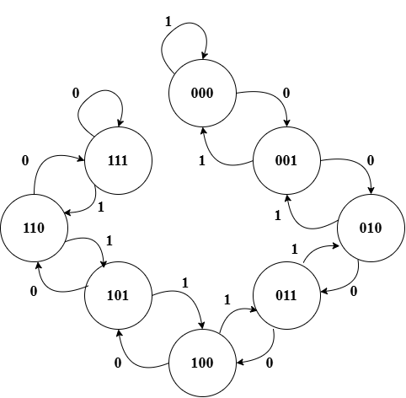
STATE DIAGRAM

Slide 9
IMPLEMENTATION

Slide 10
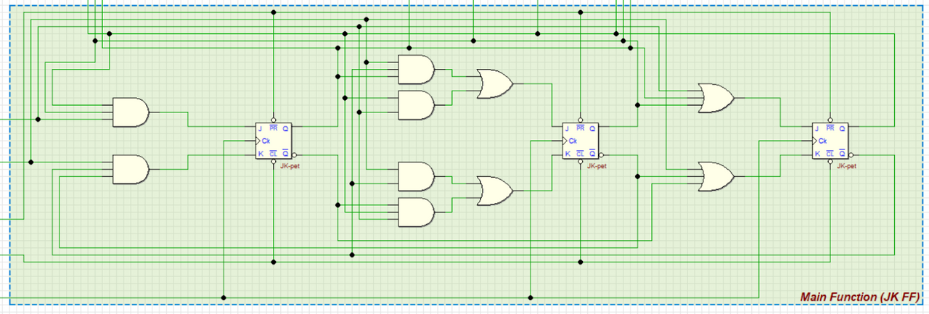
MAIN FUNCTION (JK FLIP-FLOPS)
  3 JK flip-flops
  Synchronous saturated
up/down counter
  Common clock
  Stop when clock disabler is LOW

Slide 11
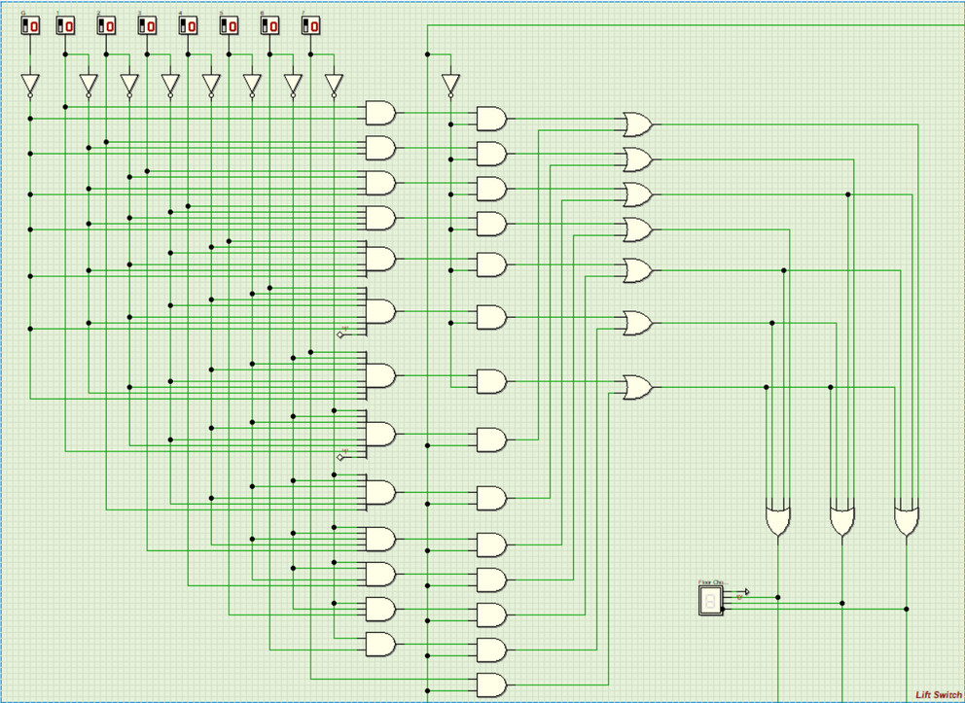
FLOOR SWITCHES
  Uses 8 floor switches
  Encoded into 3-bit destination floor
  Supports multiple selections
  Priority based on the direction of the lift

Slide 12
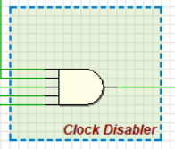
CLOCK DISABLER
  5-input AND gate
  HIGH when 5 inputs are HIGH
  Inputs:
- Clock Generator
- Password Comparator
- Floor Comparator
- Card reader
- Power switch
  Start and stop the lift operation

Slide 13
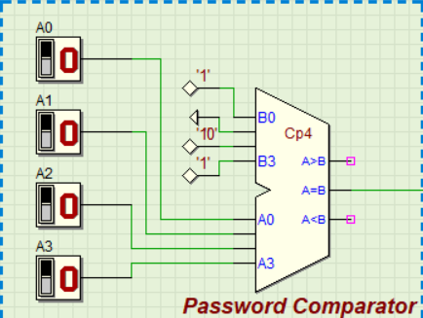
PASSWORD COMPARATOR
  4-bit MSI Comparator Chip
  Verifies the password entered
  Only outputs HIGH when the password entered is exactly equals to the preset password: “1101”

Slide 14
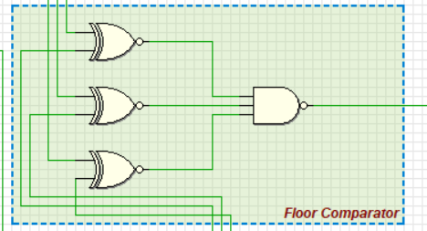
FLOOR COMPARATOR
  Uses XNOR + NAND gates
  Compares current floor and desired floor
  Output:
- HIGH → Floors not equal
- LOW → Floors are equal

Slide 15
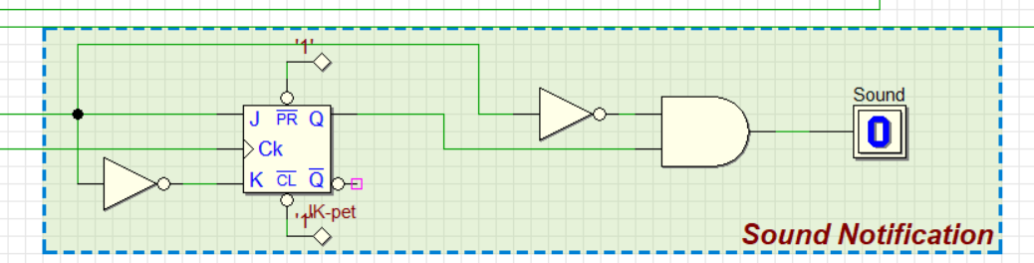
SOUND NOTIFICATION
  Configured a JK flip-flop to D flip-flop
  Stores the comparator result one clock cycle earlier
  2-input AND gate
  Operation:
- Floor ≠ Desired: AND=0 →sound OFF
- Floor = Desired: AND= 1 →sound ON
- Next clock: AND=0 →sound OFF

Slide 16
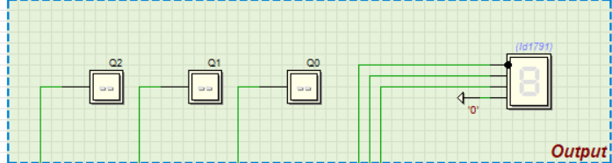
CURRENT FLOOR DISPLAY
  Shows current floor
  Display in both binary and hex form
  Driven by JK flip-flops

Slide 17
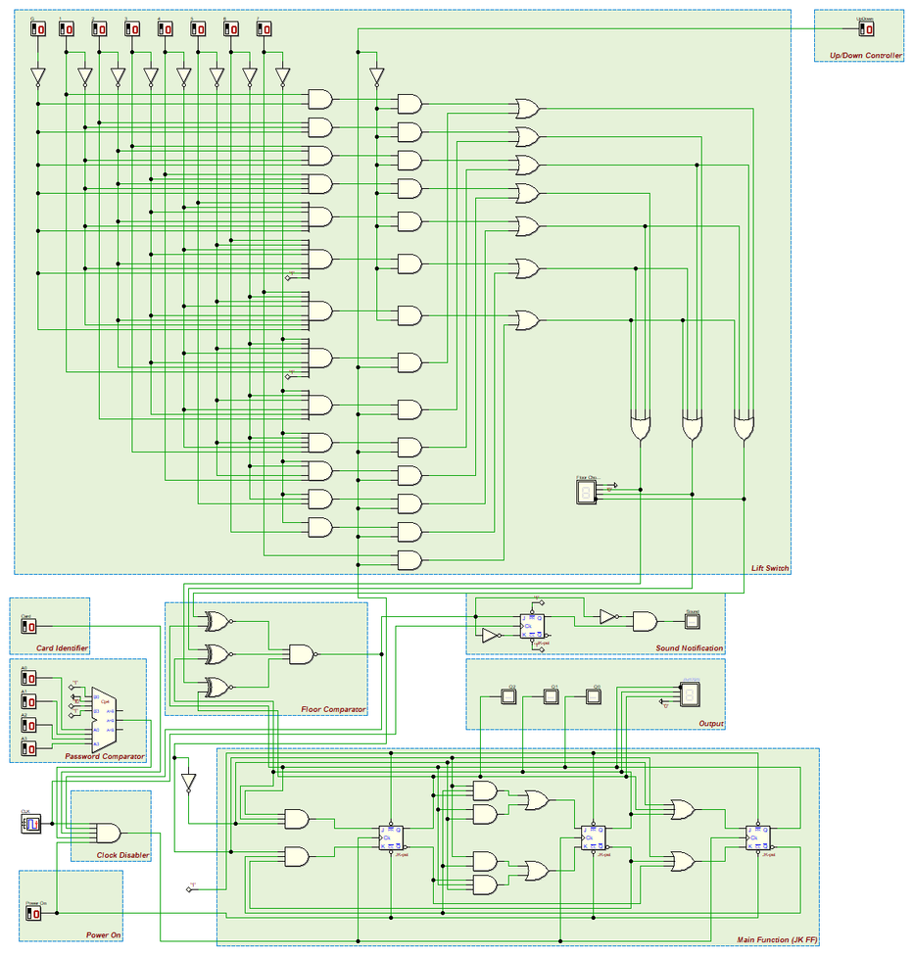
FULL DIGITAL ELECTRONIC DEEDS CIRCUIT

Slide 18
CONCLUSION
  Demonstrated the design and implementation of an elevator.
  Designed by implementing a 3-bit synchronous counter and other components.
  These collaboration of components enable the function of the system.

Slide 19
REFLECTION
  This project enhanced our knowledge in Digital Logic.
  Provided many practical experience in the application of digital electronics concepts.
  We’re excited to implement more complex circuit in the future.

Slide 20
THANK YOU

